Slide 1
Angular: basics
501
Pavliuk Maksym

Slide 2
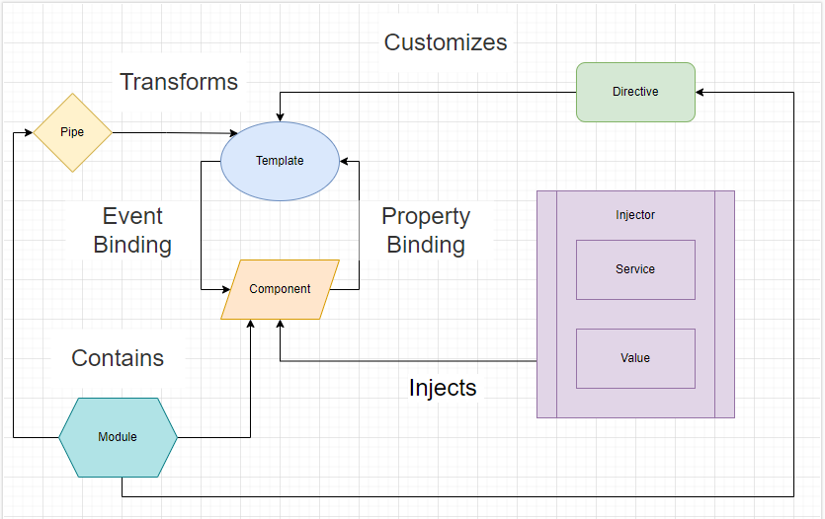
Full Picture

Slide 3
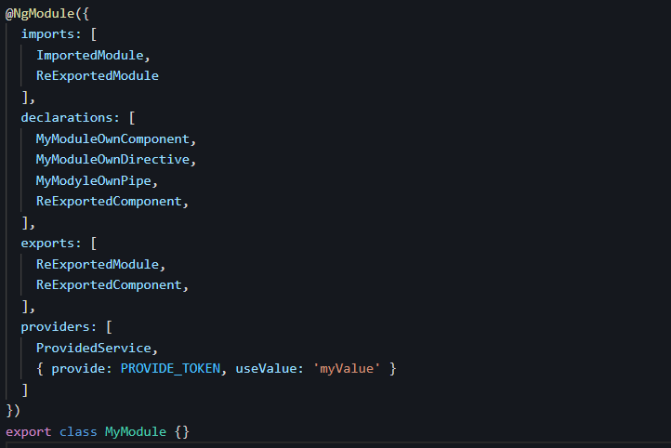
Modules:

Slide 4
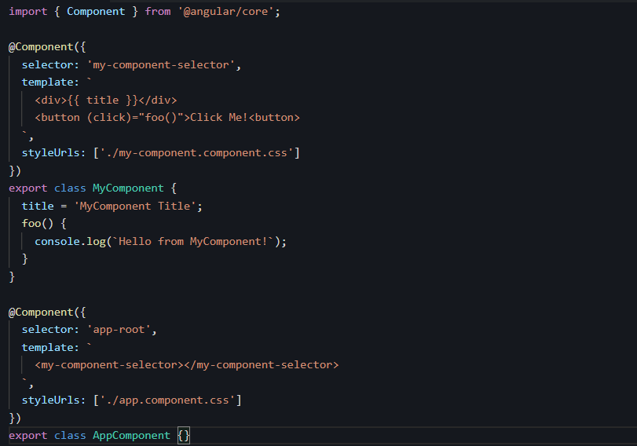
Components:

Slide 5
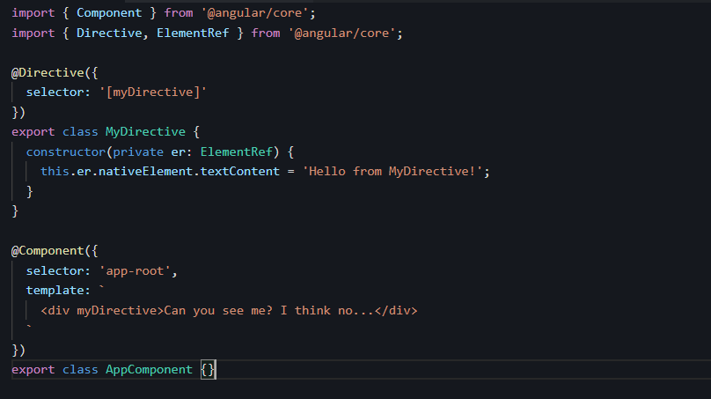
Directives:

Slide 6
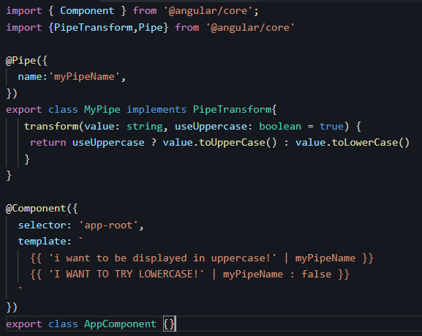
Pipes:

Slide 7
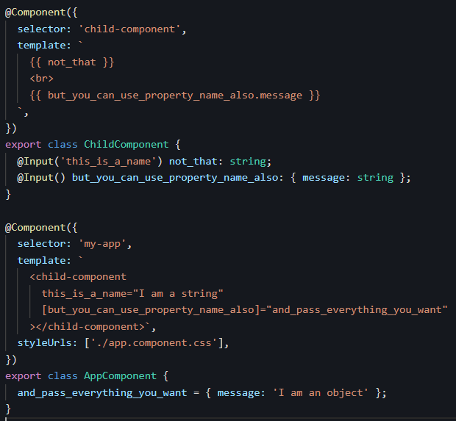
Property Binding:

Slide 8
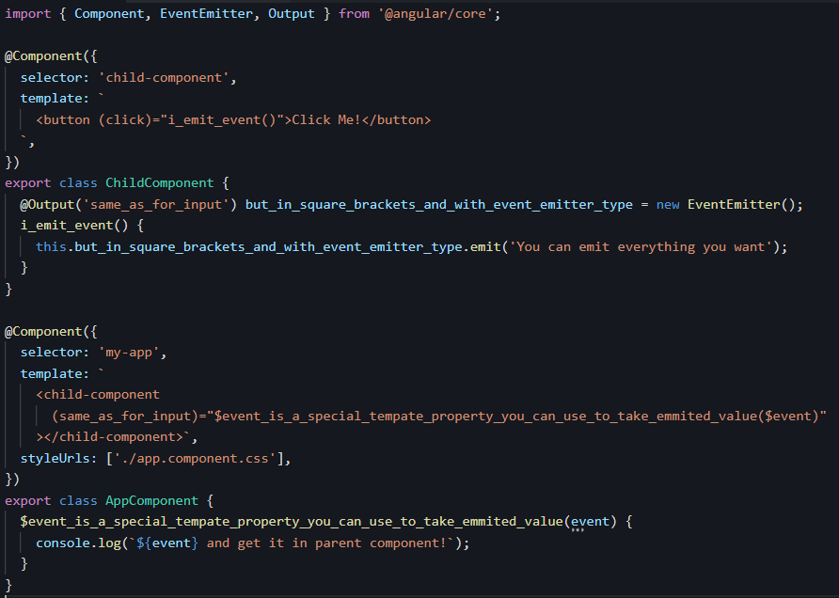
Event Binding:

Slide 9
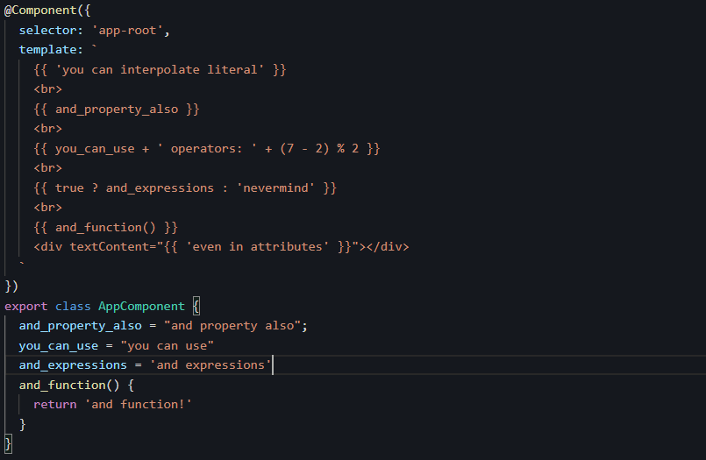
Interpolation:

Slide 10
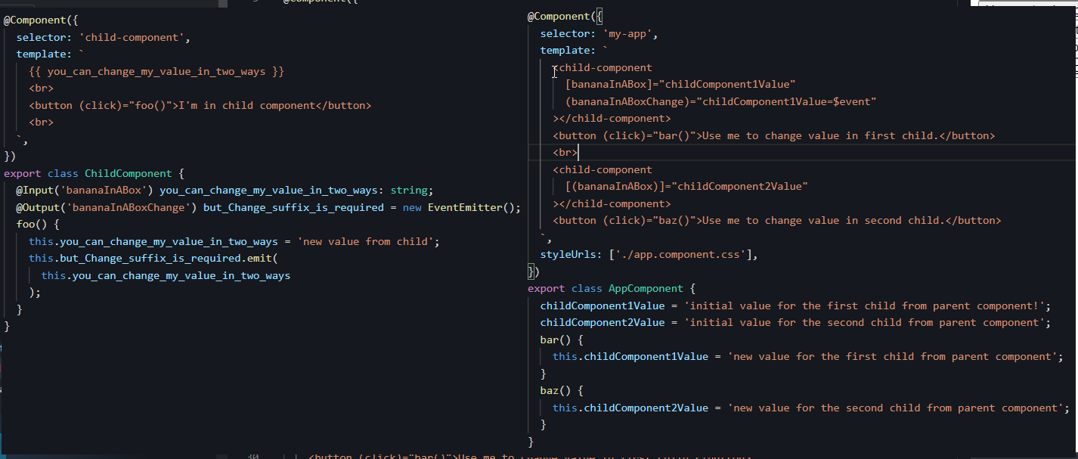
Banana in a Box
P.S. Two-Way Data Binding

